Slide 1
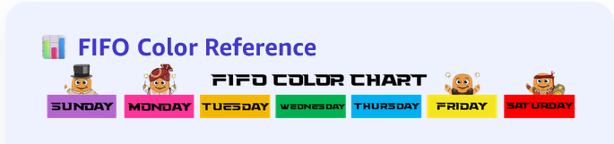
Problem Solve Tips
These are some helpful tips for problem solving.

Slide 2
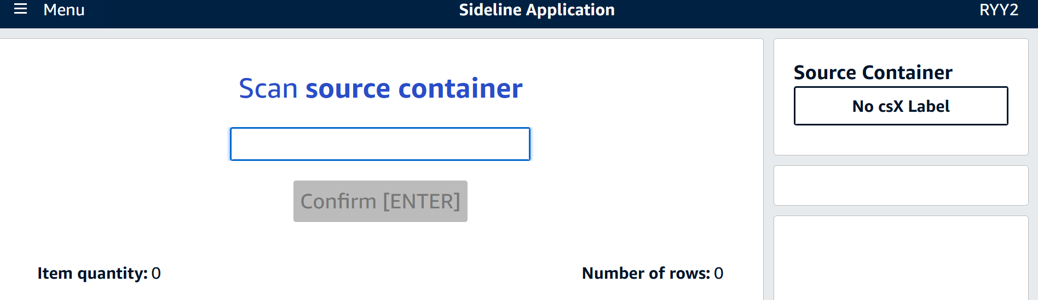
Sideline App
The Following defects
Unexpected Item Overage (UIO):The item in the container physically does not match what the container virtually
ASIN-Stickering: Barcode is missing, damaged, or unscannable.
UPC Linking: When a user scans an unlinked UPC, sideline-app will attempt to link the UPC the item in the container.
Unexpected Container Overage (UCO): Container requires virtual transfer from another FC
Move Items: Virtually transfer inventory from the source container to the destination container
Damage an item: Marks as WHS_DAMAGED
Shortage: Used to remove virtual inventory from containers that are physically empty.

Slide 3
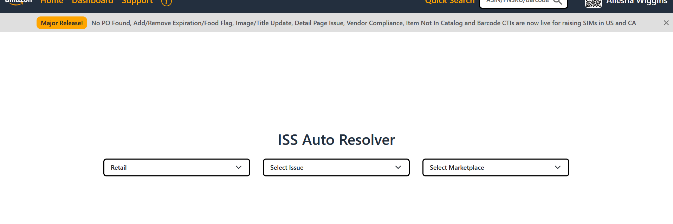
Tickets
No PO, Barcode Linked To Wrong Asin, Item not in catalog
https://na.iar.rbs.amazon.dev/home

Slide 4

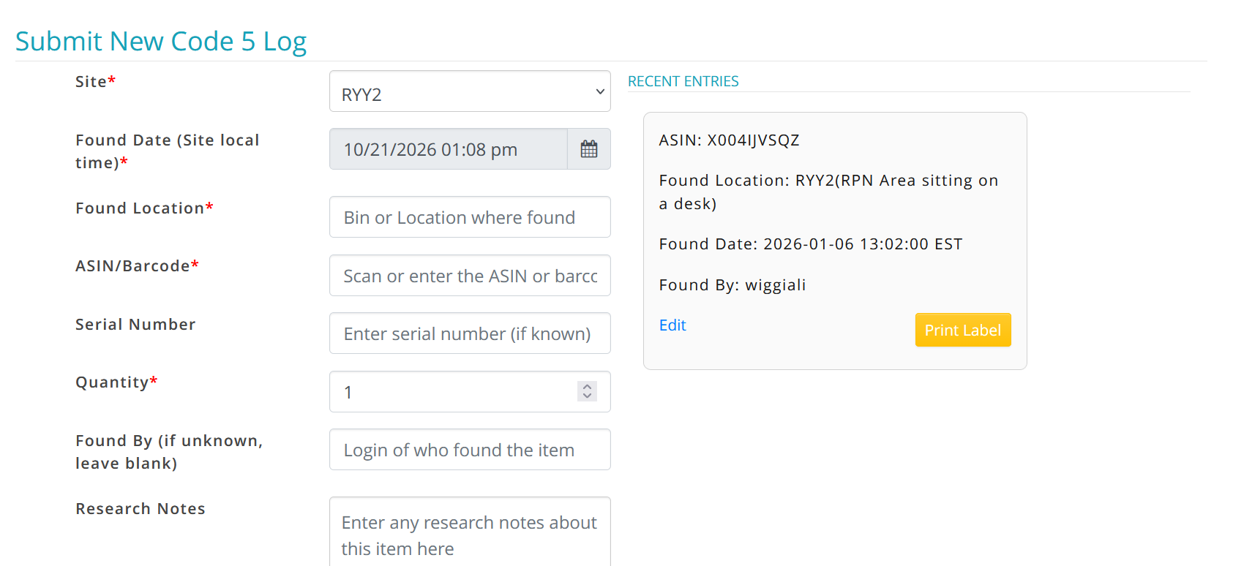
CODE 5
Suspected theft items should be DAMAGED OUT and a CODE 5 Log should be logged using this link https://lossprevention.amazon.com/codefs/new /If the suspected theft item cannot be attached to the tote (does not have an ASIN) then a ticket needs to be created for it (Please attach the DAMAGE QA FORM to damaged items)

Slide 5
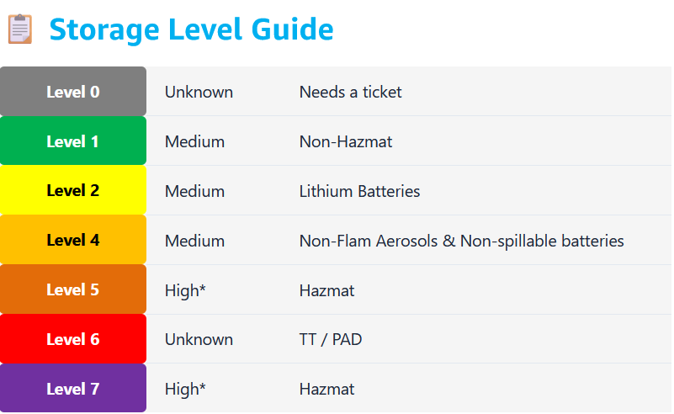
PANDASH * /Hazmat
Used to show cerftified hazmat level for ASIN’S
IXD Site can receive level 1-5 hazmat
Pandash Link - https://pandash.amazon.com/
Level 0 (Grey) requires a HCC ticket https://river-iad.amazon.com/RYY2/workflows?buildingType=fc&q0=3654ec14-7232-4f65-84c3-87927cdb4d0c&q1=f2738dec-7f6f-4c2e-a85a-db7228de25f1&id=f2738dec-7f6f-4c2e-a85a-db7228de25f1
Can on use BOO,IBSN Label
FNSKU WILL NOT WORK
Level 5,6,7 Come straight to ISS NO TICKET NEEDED

Slide 6
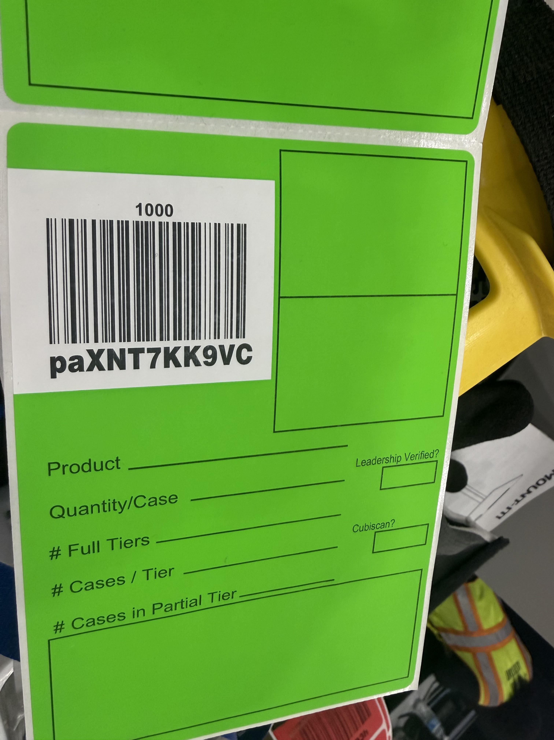
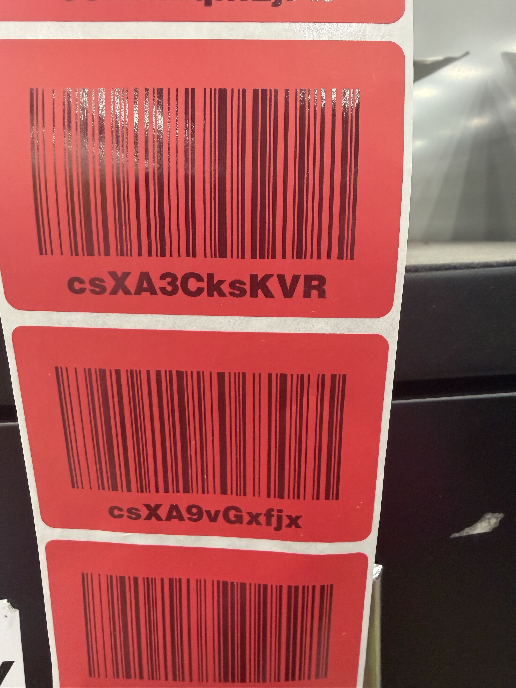
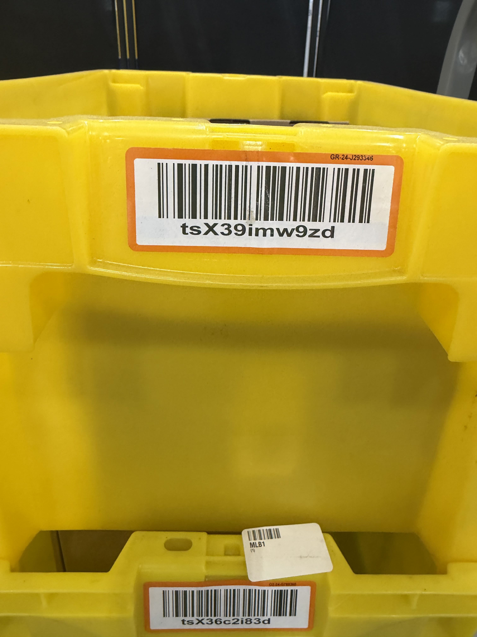
Source Container Overview
CSX:
“c” is for cases/cartons
PAX: “p” is for placed a single
asin pallets
TSX: “t” is for totes
SORT CAN USE DUMMY CONTINERS ONLY FOR THE ITEMS COMING DOWN THE LINE

Slide 7
Step By Step PS OUTBOUND
Problem solve Outbound: Basics
-First you want to scan the FBA label for the SSCC label in FC research.
-Go to FC research click on the item click on purchase order items and make sure that unfilled and canceled has zero if not this means it will need to be received.(EACH)—
-Always make sure there is inventory on FC research and that it matches the item in the container.
-If you do not see inventory you can always go to inventory history and click on the calendar go back as far as it will let you in the dates and then it may have inventory.
-Check the Carton General information to make sure the item has been received and the CSX matches if not, it can be side lined.
You want to see sellable unowned after you see this you want to transship the item which will then give you a destination.
Scan the item again in FC research to make sure it says sellable transshipment.
-If an item will not transship and it’s saying Failed to get destination check in FC research under sortable and make sure it says true if it says false that means you have to sideline that item out of that tote that it cannot be sorted with another item.
-Also if it gives you this failed to get destination, then you can scan the B00 in pandash click on US .If it shows gray its level 0 it needs a ticket through River then brought to ISS. If it’s red it’s level 5 and it comes to ISS.
The following Dispositions will come to ISS:
In Quarantine
Damages (unless it is transship)
Expired
Defective
Pending Research
ISS tickets(No PO, Item not in Catalog, Barcode links wrong item, Barcode not linked. )
Hazmat (HCC tickets) (Level 0 through RIVER)
Problem Receive
-Only use Side line if there is inventory in the box and that the item has been received, and that there is nothing unfilled or canceled.
-You can use sideline when damaging an item 1st-scan the container the item comes in 2nd Scan the damaged item 3rd click on damaged. 4th put the quantity. ***Make sure you double bag anything leaking make sure you print the ASIN stick it to the outside of the bag and ALWAYS fill out a damage form. Be sure to wrap any kind of glass or broken objects in bubble wrap.****

Slide 8
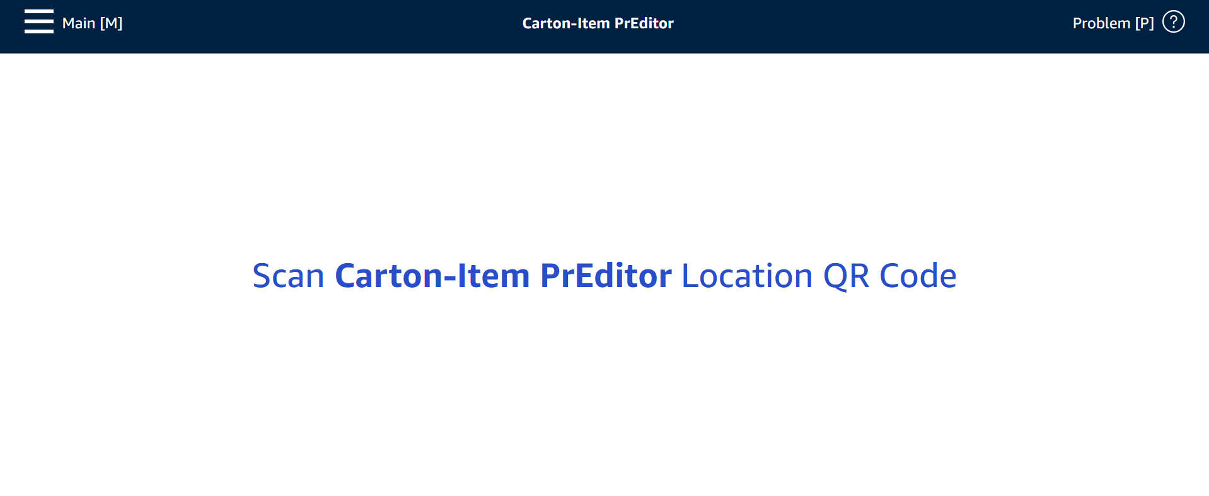
Step By Step Inbound PS
Open Carton Pre-Editor scan all the label's on the box, press enter and it will give you a destination for the case.(PIDS)

Slide 9
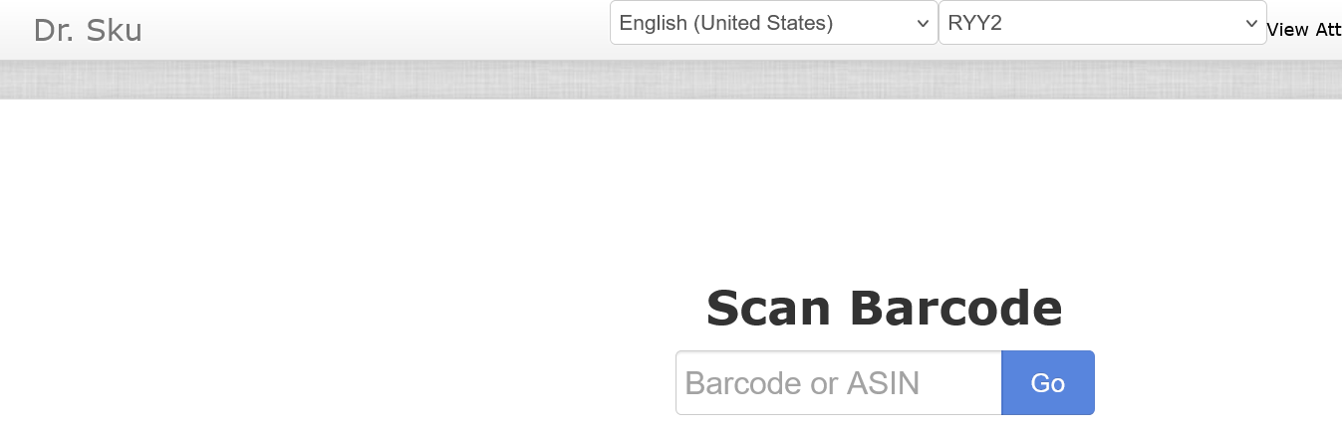
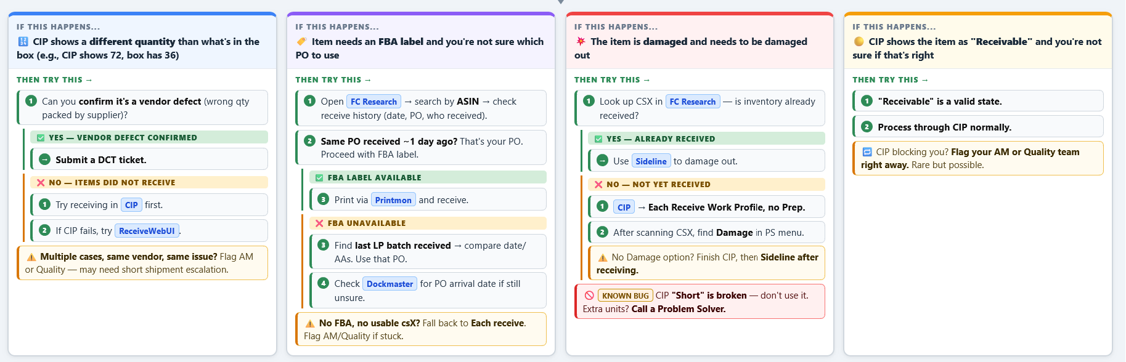
Step By Step RPN
Open FC Research: check and see if the item has been received if it hasn’t receive it in.
Problem solvers can use the PO to receive items in, but NOT on a station
If you cant find the item, use DR.Sku

Slide 10
Step by Step PS :SORT
-When working on a carton first scan the csX in FC research to see if the box has inventory. If it does, verify that the inventory matches what is actually in the box. If it matches make sure the asins are scannable and print more if needed. If not, then scan the FBA to find the PO and verify that the items from the box are in the Purchase order items. Here you will be able to see if the items have already been received, or unfilled or canceled. If unfilled or canceled they will need to be received.
Damages: When coming across a damaged item in a box or tote, side line the item in to another tote. (If it hasn’t been damaged out in the system you can do this while going through the side line process.) Only 1 unique asin per tote. Make sure the item has been virtually moved to tote, that it has been bagged, that an asin has been placed on the outside of the bag, and the item is marked unsellable. ( if the item still says transshipment in fc research use the unbind tool from the ryy2 problem solver page ) Then fill out a damage form and place in tote to take to ISS.
If there are overages left in box: If there are no unfilled or canceled of that item you can use the csX of that box to side line. It will say zero but that csX is still tied to that PO. You can only sideline an item that has a PO. If you come across and Item and find there is no PO you will have to fill out an ISS resolver form which can be found on the ryy2 problem solve page. If someone comes up to you for a label first verify that the item matches what is in the box or tote before printing and handing them a label. This will help prevent labels being put on items where they don’t belong.

Slide 11

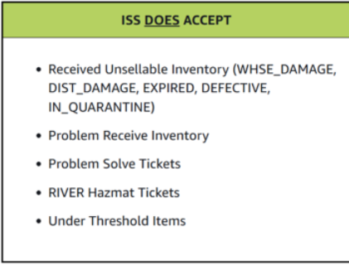
Should bring pallets each period !
ISS Drop-Zone Closure Notice
Reminder: Please remember anything for ISS has to be dropped off by 3:30PM

